Slide 1
Airport Simulator Team 08 (Dungeon Masters)
Restricted © Siemens AG 2019
Realize innovation.

Slide 2
Content Problem Statement Demonstration Illustration of our simulation Optimization Class diagram Technology Stack Project Statistics Implementation traceability

Slide 3
Problem Statement
Design a new airport where the key decision is to find optimal number of gates.
Number of emergency landing that can be handled.
Make it modules reusable.

Slide 4

Demonstration

Slide 5

Illustration of our simulation
start
Exit
r'
r
Landing on runway
Take-off on runway
a
e
Boarding time
Gates
Queuing for runway
Queuing for gates
b
d

Slide 6
Optimization
 | G | NG | G | NG | G | NG | Avg. Wait Time
 | 1 | N-1 | … | … | N-1 | 1
1 | W11 |  | … |  | W1N |  | W1
2 | W21 |  | … |  | W2N |  | W2
: | : |  | … |  | : |  | :
N | WN1 |  |  |  | WNN |  | WN
N = Number of flights
G : Grounded
NG: Non-Grounded
Wij =Wait time
i = number of gates
j = state number

Slide 7
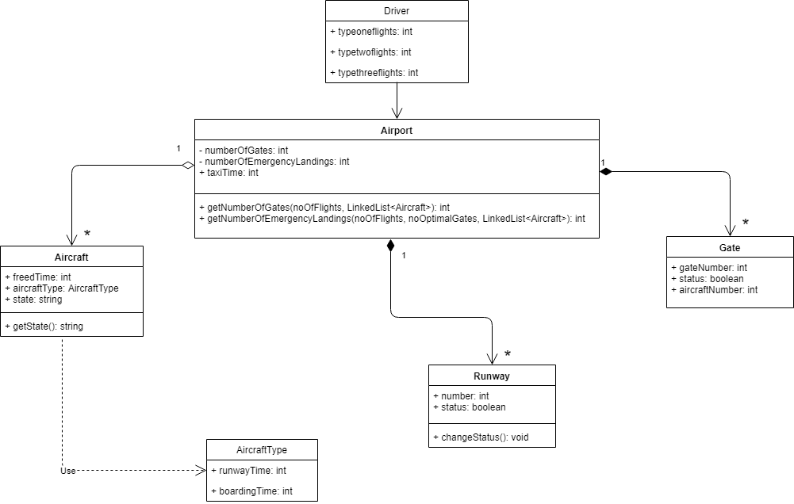
Class diagram

Slide 8
Technology Stack
Language | Java
UI/UX Framework | Java Swing
External Libraries | JFreeChart (Java Chart Library)

Slide 9
Project Statistics
Total number of code lines | 1009
Number of code files | 9
Total number of commits in git repository | 108 commits
Average number of commits per day | 6 commits/day

Slide 10
Implementation Traceability
Functional :
Sr No | Requirements | Priority | Status
1 | The system should be able to come up with optimum number of gates the airport should have so that there will be no congestion. | Required | ✓
2 | In case of emergency, the system will be able to determine how many emergency flights it can accommodate at a given situation. | Required | ✓
3 | Graph representation of number of gates plotted against number of people/ number of flights. | Desired | ✓
4 | There will be provision for feeding information through questions and answers on a terminal. | Required | ✓
Non-Functional :
Sr No | Requirements | Priority | Status
1 2 | Modularity System will be modular so that it can be further extended. Modules can be reused in any other application wherever applicable. | Required | ✓

Slide 11
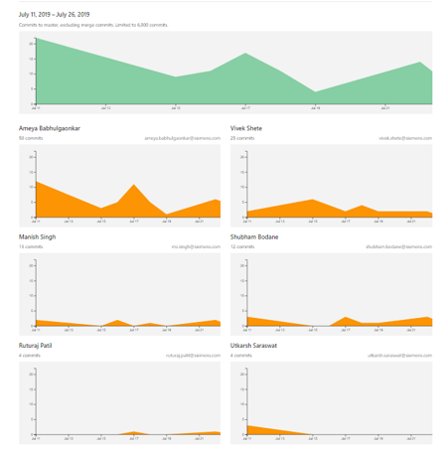
Contributors

Slide 12
Key Challenges
To come up with an algorithm which will consider all of the cases possible, for calculating optimal number of gates.
Deciding algorithm for emergency flights.
Learning
Agile method to develop a product.
Requirements and design should be complete and clear before starting the implementation.

Slide 13
Mentor: Shubham Kamble
Team 8 : Dungeon Masters
Members: Ameya Babhulgaonkar
Manish Singh
Ruturaj Patil
Shubham Bodane
Utkarsh Saraswat
Vivek Shete

Slide 14

Thank you.

